Slide 1
https://www.youtube.com/watch?v=ylR21fezN7E

Slide 2
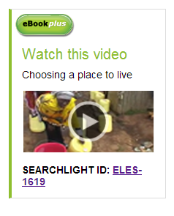
Consider why you live where you do?
Sub heading:
Video: Choosing a place to live
Identify 5 reasons why people live where they do from the video clip
What are the two types of factors.
https://www.youtube.com/watch?v=PyTEkGuP618

Slide 3
What creates a sense of place?
Notes:
To understand what a place is, one needs to consider it’s location and where it is in it’s region.
Each place has its own unique identity making it different from other places.
The characteristics of a place make a place different
Natural
Human
Combination of both.
Over time one of these characteristics becomes the distinctive feature of that place.

Slide 4
Why do people live in certain places?
Ref page 104 text
Note taking
The reasons people live in different places can be divided into:
Pull factors
Push factors
Write out a definition for each see BRH corner page 105.
Reasons can change:
From person to person
Over time
Four factors that influence liveability:
Available resources
Employment
Relationships with other people
lifestyle
These factors can change throughout a persons life as they age and their needs change.

Slide 5
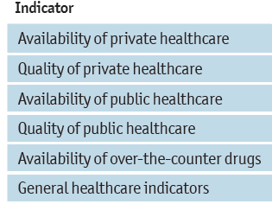
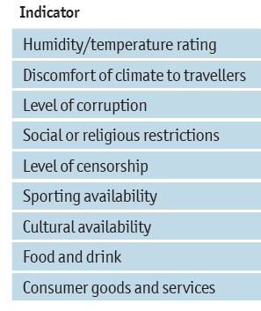
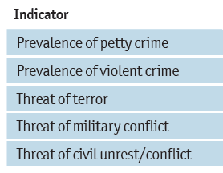
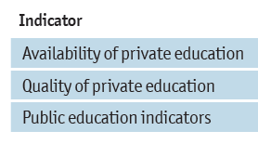
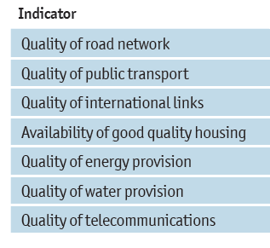
How does ‘The Economist Intelligence Unit’s liveability survey’ rank cities for liveability?
Criteria & weighting used:
Stability (25%);
healthcare (20%);
culture and environment (25%);
education (10%); and
infrastructure (20%).
Each factor in a city is rated as acceptable, tolerable, uncomfortable, undesirable or intolerable
Notes:
The PDF of this report is on the drive. Click to show the indicators used.

Slide 6
Create a Town.
Using Play Dough

Slide 7
What are the most important factors of your town?
safe,
easy to get around,
interesting,
makes people happy to live there.
Education
Health Care

Slide 8
In Groups of 4: Using the ‘Placemat’ each student writes down 5 of what they believe are the most important factors/features, which make a community a safe and happy place in which to live. Negotiate an agreed list.
Agreed list
5 individual
5 individual
5 individual
5 individual

Slide 9
Create a class definition of liveability
Definition from Aus Curriculum:
An assessment of what a place is like to live in, using particular criteria, for example, environmental quality, crime and safety, education and health provision, access to shops and services, recreational facilities and cultural activities

Slide 10
Livability is the sum of the factors that add up to a community's quality of life—including the built and natural environments, economic prosperity, social stability and equity, educational opportunity, and cultural, entertainment and recreation possibilities.

